Slide 1
Android Security App for Senior Citizens
Shri Shankaracharya Institute of Professional Management & Technology, Raipur
Major Project(Phase-I) Report on
CSE 7th Semester
Department of Computer Science and Engineering,
Batch 2019-2023
Session 2022-23
Presentation Date: 24-01-2023
Project Guide
Mr. Anand Tamrakar
(Asst. Professor,
Departmentof CSE)
Project Group Members:
Mayurakshi Singh
Geetika Malewar

Slide 2
Introduction
The goal of this research is to spotlight the current scenario of senior citizens, the problems faced by them and providing them a life-saving piece of technology.
Senior citizen’s safety is a big concern which has been an important topic till date. Few issues faced by them includes lack of shelter, fear, depression, senility, isolation, boredom, non-productivity, and financial incapacity.
Most of the people of this age group, till this day are being subjected to distress and vulnerability. Although the government is taking necessary measures for their safety, still, there are measures that can help them to stay safe.
Most of the senior citizens these days carry their smartphone with them, so it is necessary to have at least one the personal safety apps installed. This is user-friendly application that can be accessed by anyone who has installed it in their smart phones. Our intention is to provide you with fastest and simplest way to contact your nearest help.

Slide 3
Application Area
The most pressing issue to far has been how to ensure the safety of senior citizens. Among older persons, falls, burns, poisoning, and car accidents are the most frequent safety issues.
These days, the majority of older citizens carry their smartphone about, thus it is essential to have at least one personal safety app installed. Anyone who has loaded this user-friendly software on their smartphone can access it.

Slide 4
Five main functions make up this end-user application:
(i) Emergency button with one click which enable the user to to add immediate and contacts of the close ones, which will help in single tap call in case of emergency.
(ii) Lists of pre-mentioned emergency contacts
(iii) Nearby safe stay is a significant tool because it gives users access to information on hospitals, hotels, and dorms near their present location.
(iv) Legal Rights module which will serve the user in gaining knowledge regarding their BasicRights, which will help them in case of conflicts and malpractices on them, and make them feel confident and secured.
(v) Healthcare which provides the user, all the locations of nearby healthcare centers/hospitals and its detail to contact them in a go.

Slide 5
Literature Review
An Android App Rapid SoS+
A power full emergency, One touch SOS alert is provided by the programme, but what's more intriguing is that it may dial 9-1-1 on behalf of a loved one and communicate that person's current position and other relevant information to the nearest dispatch centre
B. An Android Application for Senior Citizen Emergency
bSafe is a mobile application for Android that offers the user multiple options; specifically, four services are offered: bSafe Alarm, Follow me, Timer Alarm, and Fake call. An automatic recording is started when this option is selected, and the recorded information is forwarded to the designated number or numbers

Slide 6
C. An Android Security App - SaveME 999
The Royal Malaysian Police (PDRM) and Telekom Malaysia (TM) collaborated on this application, which is available to Malaysian nationals and enables victims to call for assistance by pressing a panic button With location detection, users can call helplines to obtain information and specifics on local emergencies
D. Emergency alarm security system
A model built on SySML and a process to ensure the safe and secure design of cyber-physical systems. The Generic Systems Engineering analysis is used to offer a system specification at first, and SySML notation is used to express a safety scenario. Identification of potential assault scenarios is made possible by the combination of these two.

Slide 7
Methodology
The algorithm is chosen to give the system the capacity to deal with a variety of emergency situations.
To ensure good system performance and to satisfy user requests, we combined the existing FCFS queue (First Come, First Served) scheduling approach with Dijkstra's algorithm. Dijkstra's approach, in contrast, looks for the quickest route between a user-selected source and a destination. In the event of heavy traffic, a different route with a different duration is chosen.
In this application, the Dijkstra algorithm is utilised to assist police and ambulances in locating individuals who require immediate medical attention when available resources are insufficient.
The end user, the receiver, and the system administrator are the three key users who operate SCS.

Slide 8
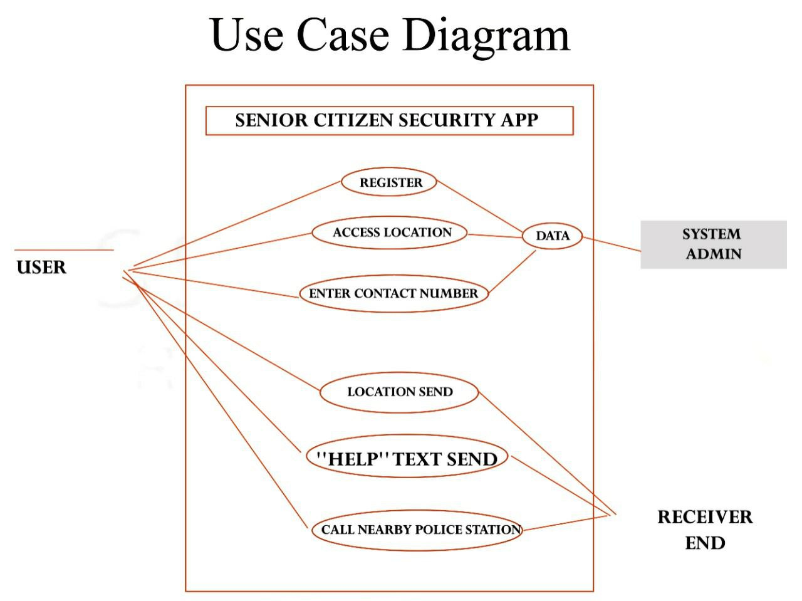
SCS is operated by three important actors as a user: the end user, the receiver, and the administrator of the system.
The application’s use case diagram is attached below to show the activities and links of each system user.
The diagram illustrates the accessibility of features to the user, receiver, and admin. Common links between the three actors are the running process of the system and interface
.
According to Fig, the main responsibility relays on users, as they must respond to the alert as soon as possible.

Slide 9
Project Work Flow Diagram
START
EMERGENCY
SOS button
LOCATE CURRENT LOCATION
''HELP'' TEXT SENT TO THE
REGISTERED MOBILE NUMBER
''LOCATION TO INFORM'' MESSAGE SENT
CALL NEARBY POLICE STATION
STOP SOS BUTTON
12
END

Slide 10
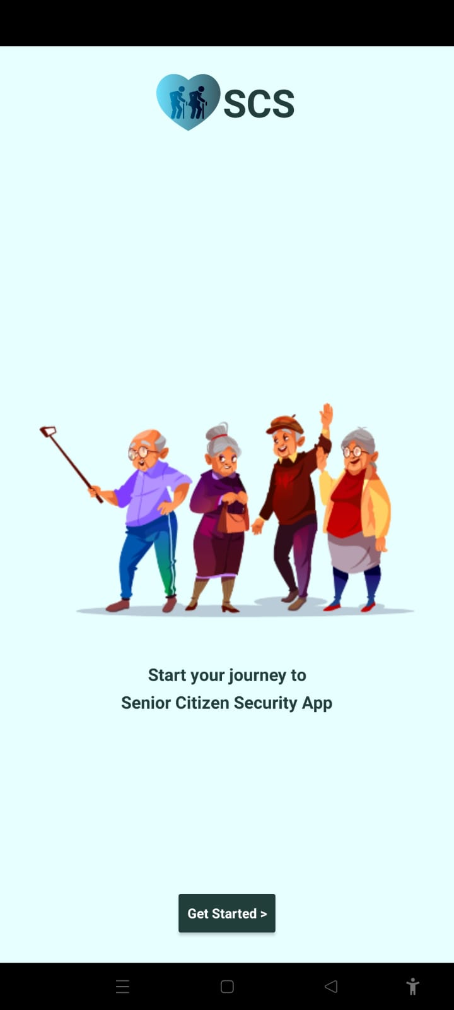
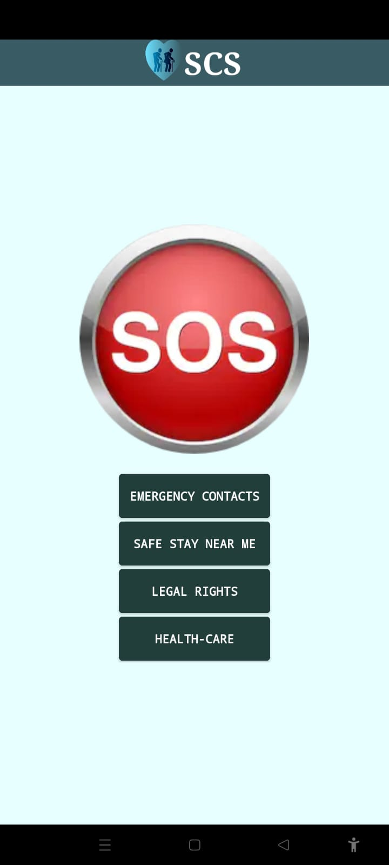
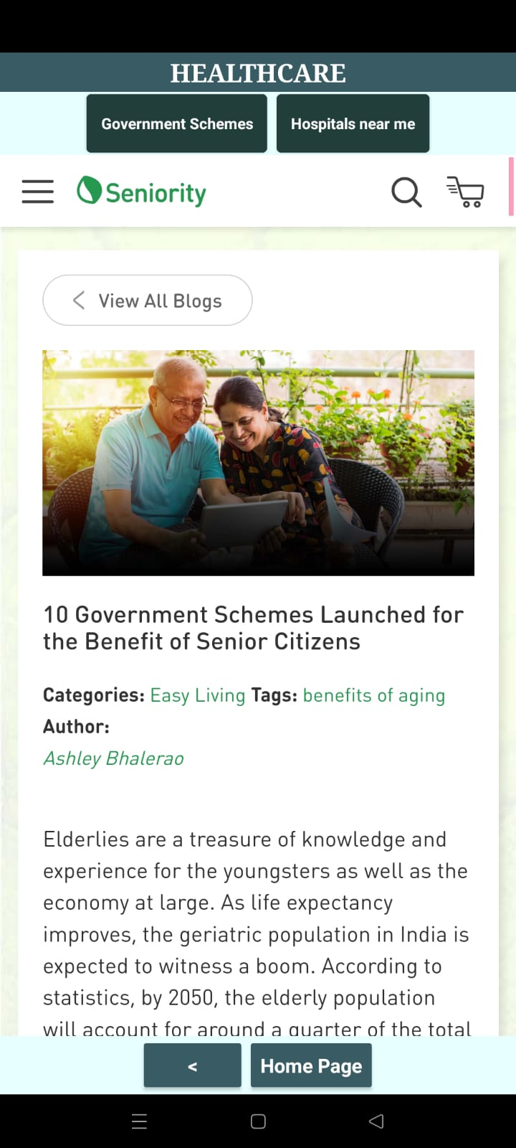
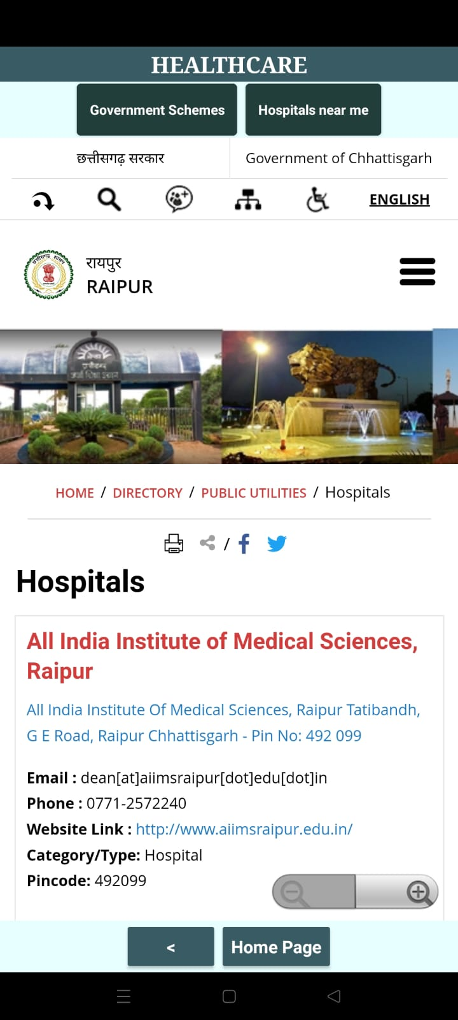
SNAPSHOTS

Slide 11
Result & Conclusion
The main advantage of this app is that it has four different features integrated in a single application. It doesn’t need any internet connection to identify the user’s location. It will ensure the safety of the senior citizens to a greater extent because of its four different features.
There are four crucial features which differentiate this app, from any other. These are the emergency contacts, Safe Stay near me, Legal Rights and Healthcare.
Hence this application will survive long and surely reduces the maximum risk of becoming a victim. This app can be developed with some more features in the future and make it more user friendly.​
Elderly or old age consists of ages nearing or surpassing the average lifespan of human beings. The boundary of old age cannot be defined exactly because it does not have the same meaning in all societies.

Slide 12
For senior citizens, the app will function as a security tool to safeguard their safety. Any handheld device running the Android operating system can use this application.
This programme offers a variety of useful options for communicating with specified contacts and calling nearby police stations while automatically providing the user's precise location.
They learn to accept and live with the difficulties of their frail and declining physical condition, as well as the loss of control at various levels, such as when they fall, from incontinence, and from the stigma of having to deal with an embarrassing situation, in order to cope efficiently.
The user's location can be determined without an internet connection. Due to its four various features, it will more thoroughly safeguard the safety of Senior Citizens. Thus, this app will endure for a long time and will undoubtedly lower the chance of being a victim to the lowest possible level. Future development of this app could add more features to make it more user-friendly

Slide 13
References
1) J. Bizjak, A. Gradišek, L. Stepančič, H. Gjoreski, M. Gams and K. Goljuf, "Intelligent System to Assist the Independent Living of the Elderly," 2017 International Conference on Intelligent Environments (IE), 2017, pp. 180-183, doi: 10.1109/IE.2017.12.
2) Noichl, S., Schroeder, U. (2020). InfoBiTS: A Mobile Application to Foster Digital Competencies of Senior Citizens. In: Alario-Hoyos, C., Rodríguez-Triana, M.J., Scheffel, M., Arnedillo-Sánchez, I., Dennerlein, S.M. (eds) Addressing Global Challenges and Quality Education. EC-TEL 2020. Lecture Notes in Computer Science(), vol 12315. Springer, Cham.
3) Pritchard, R. E., & Potter, G. C. (2011). Senior Citizens, Social Security, And Healthcare Costs. Journal of Business & Economics Research (JBER), 9(1).
4) X. Zheng and P. Pulli, "Towards High Quality Mobile Services for Senior Citizens in Smart Living Environments," 2007 International Conference on Multimedia and Ubiquitous Engineering (MUE'07), 2007, pp.

Slide 14
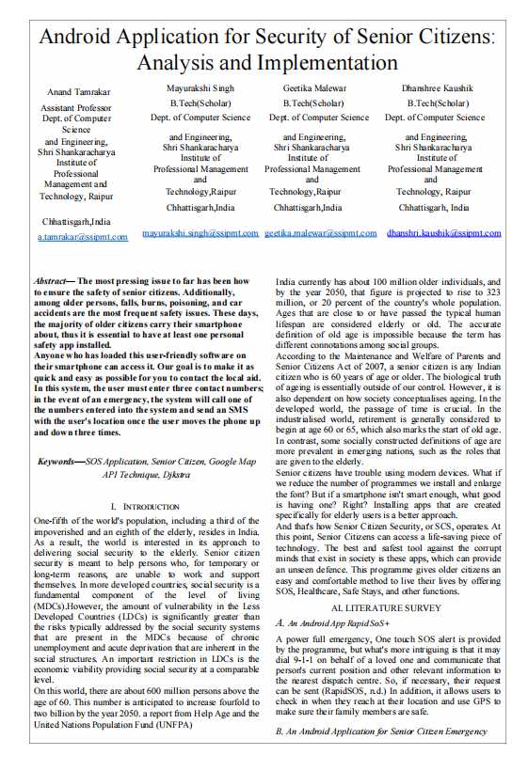
Paper Publication Details

Slide 15
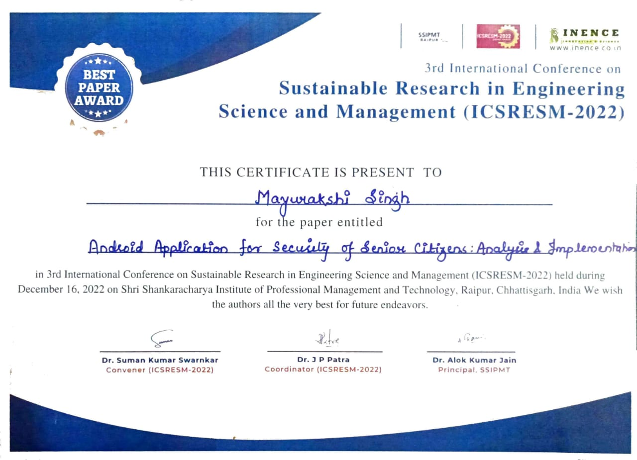
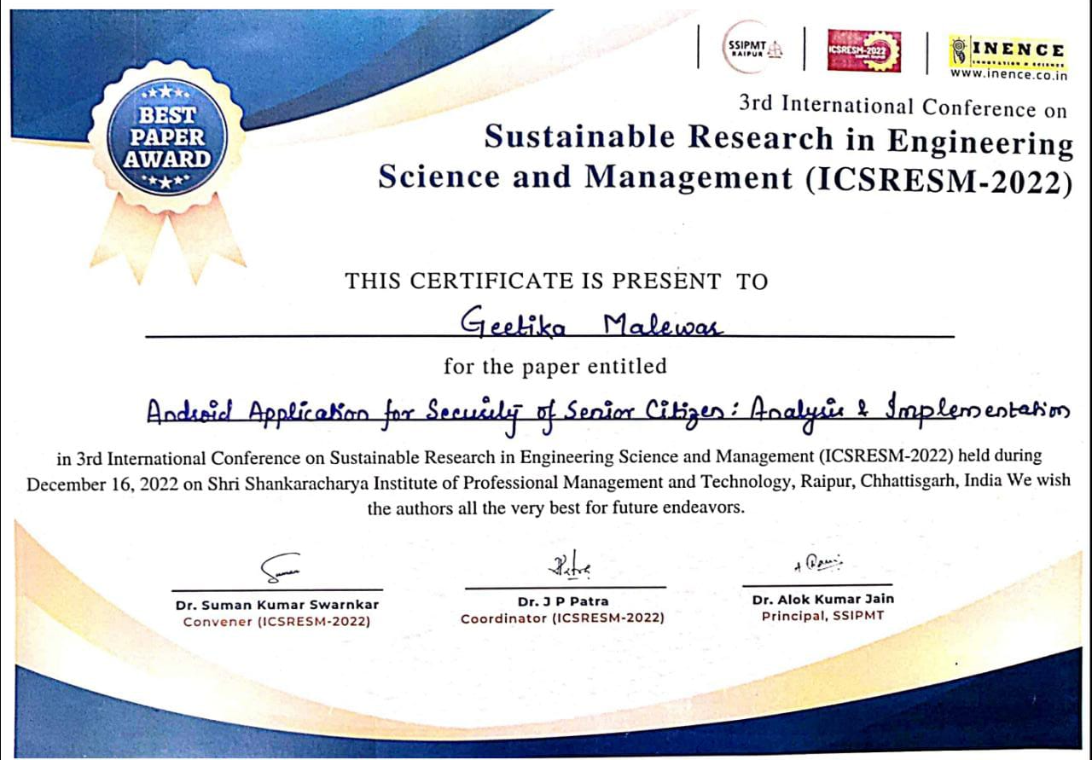
CERTIFICATE (Best Research paper award)

Slide 16
THANK YOU

